Slide 1

COVID- 19 CASE STUDY ON CHINA

Slide 2
ABSTRACT:
The coronavirus disease (COVID – 19) outbreak in China was first reported to the World Health Organization on 31 December 2019.
The COVID – 19 pandemic has impacted the economy, livelihood and physical and mental well-being of people worldwide.
Gradually, the pandemic is under control through non-pharmaceutical interventions, and the mass vaccination program has been launched to further prevent the disease.
But still there are few cases in several countries and the new variant of the virus also emerging around the world.

Slide 3
MYSTERY??
The first known infections from SARS‑CoV‑2 were discovered in Wuhan, China.
The original source of viral transmission to humans remains unclear.
Because many of the early infectees were workers at the Huanan Seafood Market, it has been suggested that the virus might have originated from the market.
However, other research indicates that visitors may have introduced the virus to the market, which then facilitated rapid expansion of the infections.

Slide 4
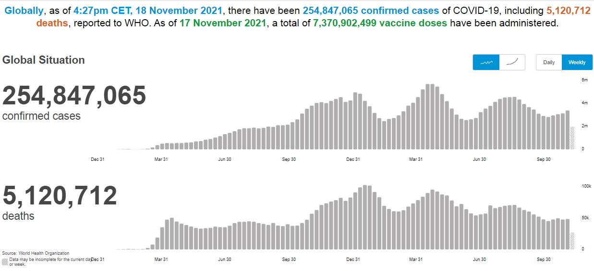

Slide 5
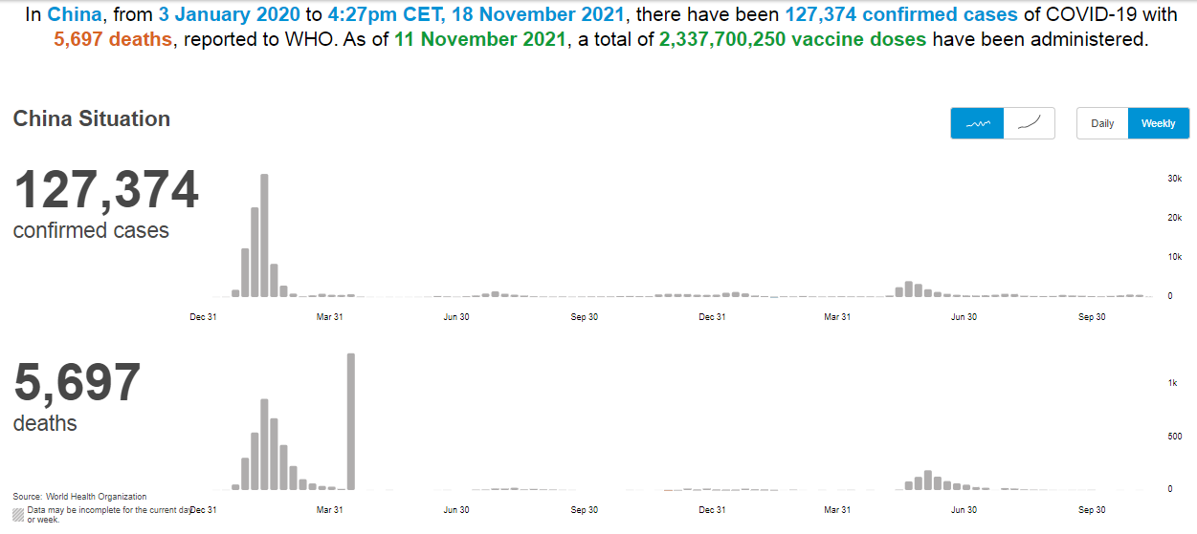

Slide 6
BUT HOW?
reporting to the public about the unexplained viral pneumonia outbreak;
intensive surveillance and epidemiological investigations;
case finding, quarantine and management;
environmental sanitation and disinfection and closure of Huanan seafood market on January 1;
public risk communication, efforts of improving public awareness and adoption of self-protection measures;
communication with WHO and other countries;
Some key responses implemented are:

Slide 7
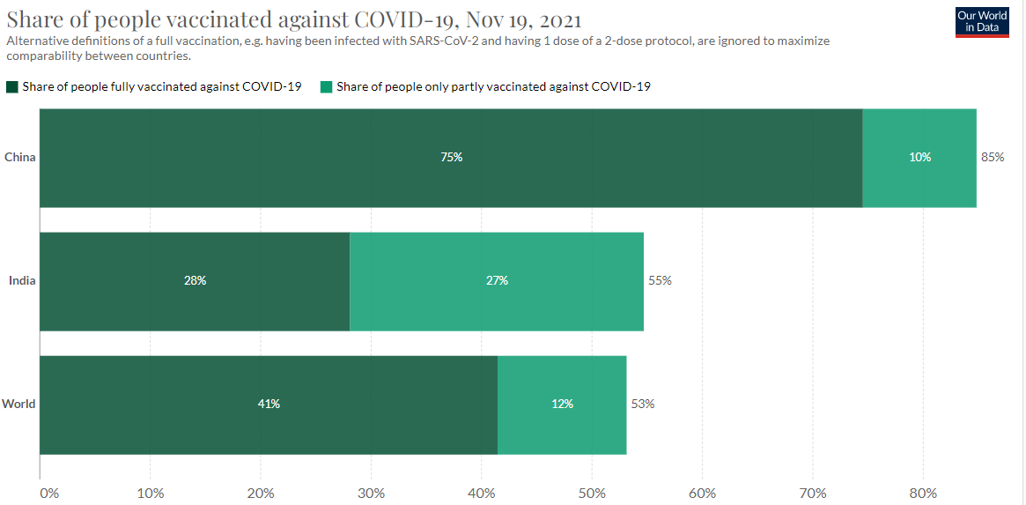

Slide 8
Secret of China’s fast and steady vaccine
The “secret” is:
People want to get vaccinated.
There is a quick efficient method to get vaccinated.
Based on various needs they can change the allocation of vaccines.
There are multiple local companies that make the vaccines. There isn’t a single provider.
Flexibility and obedience of the people.

Slide 9
How has the economy of China been affected by COVID and what China did to overcome the losses?
Retail sector get hit first.
Then transport sector as well, as travel both domestically and internationally grind to a halt.
Since China is not only a producer but also a big consumer, there will be a reduction in China’s demand on products from other parts of the world.
In order to deal with the adverse impact of the epidemic on the economy, China has stepped up counter-cyclical adjustments and financial support.
Various localities and departments have introduced measures to increase support for enterprises and targeted support for exports and imports.
Promote trade in services, prevent and control risks, and stabilize foreign trade.

Slide 10
Mitigating learning losses and protecting health and well-being
Learning Continuity
Disrupted classes undisrupted learning(DUCL).
Online learning resources.
Safe operations and community participation
Policies and protocols on prevention and control.
Sanitation and hygiene.
Health and well-being
Physical exercises and psychological support.
Healthy network environment.
Financial support
Measures to support the economic recovery process.
Financial assistance.

Slide 11
THANK YOU!

